Slide 1
Career & Life Planning
EPSY 220
TA: Matt King
Class 2

Slide 2
Topics
Six skills for effective career planning
Self-Assessment: CSS & CCS
Definition of work and career
Maslow’s hierarchy of needs
Lifestyle triangle
Super’s Roles & Stages
Stages & Career myths activity

Slide 3
Defining Work and Career
Get into groups.
Come up with definitions for: Work and Career

Slide 4
Defining Work and Career
Work: to labor, an activity done for a purpose that expends energy
-- or--
To be employed for the purpose of making enough money to live
Career: the progress through life with respect to one’s pursuit. One’s lifework.

Slide 5
What is Career?
Career: “a time-extended working out of a purposeful life pattern through work undertaken by the individual” (National Vocational Guidance Association, 1973)
Career Development: “The total constellation of psychological, social educational, physical, economic, and chance factors that combine to shape the career of any given individual. (National Vocational Guidance Association, 1973).

Slide 6
Defining Work and Career
Was it hard to distinguish between these terms?
What are the similarities and differences between work and career?
Does work and/or career always involve making money?
Why might someone what a career over work? Vice versa?
Now and in the future, are you looking for work or a career?

Slide 7
Six Skills for Effective Career and Life Planning
Decision making
Self-assessment
Gathering/Assessing career info
Integration of self-assessment, career info & environmental influences
Marketing yourself
Work adjustment & expansion

Slide 8
Questions to consider…
Who are you?
How do you want to live?
Where do you want to live?
Who will you spend your time with?
How will you make this happen?

Slide 9
“Scientific” Self- Evaluation
Fill out the Career Salience Scale (CSS)
High scores indicate that a successful career is important to you.
Fill out the Career Concern Scale (CCS)
High scores indicate a greater level of career concerns.

Slide 10
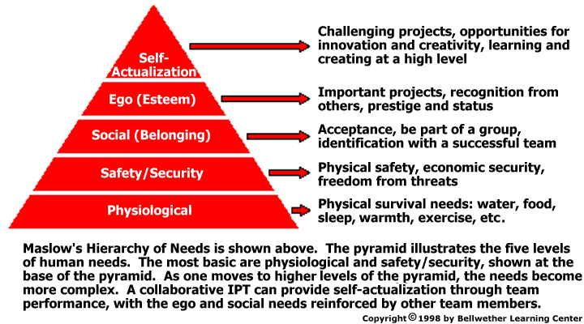
Maslow’s Hierarchy of Needs

Slide 11
Lifestyle Triangle
Leisure/hobbies/Recreation
Family/Kinship/
Friends
Work/Career/Student

Slide 12
Lifestyle Triangle (Exercise)
What was your triangle like at 5? At 15? Now?
What will it be like after graduation? At 35?

Slide 13
Career Development Stages
Super’s Selection Stages
Growth
Exploration
Establishment
Maintenance
Disengagement

Slide 14
“Super” Roles! Who are you?
Child Homemaker
Student Parent
Citizen Life-of-the-party Worker Partner
The salience of these roles will shift over time.
What are some other roles that Super didn’t mention? How salient are they to who you are?

Slide 15
Sample Career Path
Growth
Late adolescence
Exploration
Young adulthood
Establishment
30s
Maintenance
Disengagement
Gathering/assessing career info
Integration of self, career info, & environment
Marketing yourself
Adulthood
Work Adjustment and expansion
Retirement age
Self assessment
Integration and decision-making

Slide 16
“Modern” Sample Career Path
Stage | Task | Age Range
Growth | Self assessment | 16 to 20
Exploration | Gather/assess career info | 20 to 22
Establishment | Marketing yourself | 22 to 28
Maintenance | Work adjustment | 28 to 30
Disengagement | Integration | 30 to 34
Growth | Self assessment | 34 to 39
Exploration | Gather/assess career info | 34 to 39
Establishment | Marketing yourself | 38 to 40
Growth | Self assessment, integration | 40 to 43
Exploration | Gather/assess career info | 43 to 44
Establishment | Marketing yourself | 44 to 48
Maintenance | Work adjustment | 48 to 50
Disengagement | Decision-making | . . .

Slide 17
Career Paths Exercise
In groups, consider each of Super’s career development stages…
Come up with an example of a person and what might happen for them at each stage.
If you were a career counselor, what would you advise this person to do at each stage?

Slide 18
Fact or Myth?

Slide 19
When we get to _____ we will have it all figured out and our lives will be perfect.
For example: when you get out of college you'll get a job and really start living.

Slide 20
Career Myth #1: Maturity
Reality: We are always in progress and looking forward to the next thing. Maybe when you get to point B you'll have what you wanted at point A. Except now you'll want what's at point C.
Lesson: Work on your goals here and now. Enjoy the process.

Slide 21
I should have it together and have clear, concise plans for the rest of my life.

Slide 22
Career Myth #2: Crystal Ball
Reality: When do we ever have the knowledge to have decided what our lives will be like. Consider: how many people still want to be what they wanted to be at 5? Yet the pressure is there, you were expected to know at 5.
Lesson: Life will throw you curve balls. It's more important to be flexible and recognize that life is a process, not an outcome.

Slide 23
Time is ticking away and the longer you take to decide, the worse off you are. When are you going to make up your mind what to do with yourself? The longer you wait the fewer options you'll have.

Slide 24
Career Myths #3: Social Clock
Reality: Career development is a life-long process, not a one-shot decision. Most college graduates change jobs 3-7 times.
Lesson: Expect to learn new things about yourself and change your mind about where you want to go. Understand that's normal. When we get to _____ we will have it all figured

Slide 25
If you do not have to be a doctor/lawyer/etc., to be successful.

Slide 26
Career Myths #4: If you're not a doctor/lawyer/etc, you're a failure
Reality: This myth isn't limited to parents. It can involve other family, mentors and friends. The implication is that we aren't valued for who we are but for what we do for a living. What scale do we evaluate these occupations on, money, prestige?
Lesson: Not everyone can be or wants to be a doctor, lawyer or Michael Jordan.

Slide 27
Work is the most important element in your life and all energy should go into it and all decisions revolve around it.

Slide 28
Career Myths #5: Work = Life
Reality: Work can equal life, but what are you working for and what are you living for? This also implies that those who don't earn a living aren't successful in life.
Lesson: Balance between roles in your life is irreplaceable. Remember the lifestyle triangle.

Slide 29
